Slide 1

Web Scraping & Automation using Python
Aziz Bohra
Vaibhav Lakhani

Slide 2
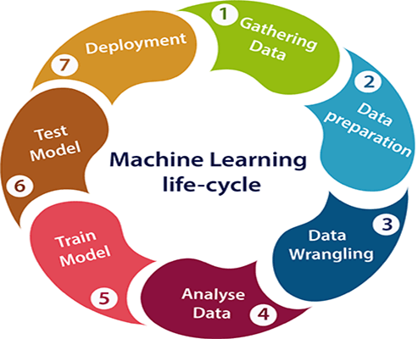
What is Web Scraping?
Web scraping is the process of using bots to extract content and data from a website.

Slide 3
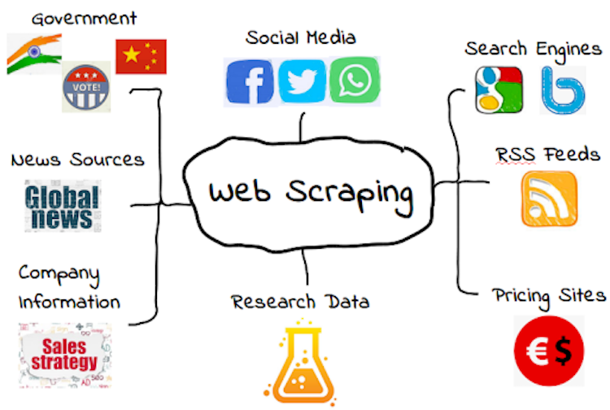
Where can we Scrape Data from?

Slide 4
Steps involved in web scraping:
Send an HTTP request to the URL of the webpage you want to access. The server responds to the request by returning the HTML content of the webpage.
Once we have accessed the HTML content, we are left with the task of parsing the data. Since most of the HTML data is nested, we cannot extract data simply through string processing. We need a parser which can create a nested/tree structure of the HTML data.
Now, all we need to do is navigating and searching the parse tree that we created, i.e. tree traversal.

Slide 5

Tools you need:
For Step 1: Request Library
For Step 2: html5lib library
For Step 3: BeautifulSoup
Installation:
pip install requests
pip install html5lib
pip install bs4

Slide 6


Slide 7
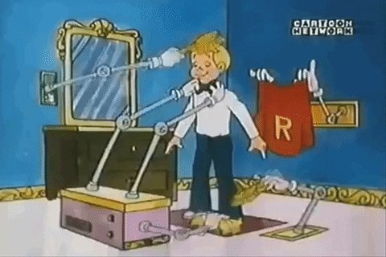
Selenium – Automating Stuff
Selenium is a powerful tool for controlling web browsers through programs and performing browser automation.
It is functional for all browsers, works on all major OS and its scripts are written in various languages.

Slide 8
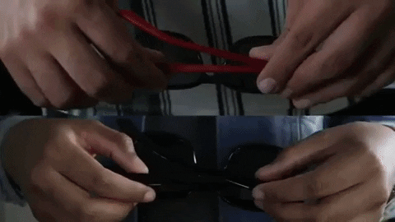
WhatsApp Bot
Automating the task of sending messages.
What you will need ?
Selenium: pip install selenium
Chrome webdriver: sudo apt-get install chromium-browser or https://chromedriver.storage.googleapis.com/index.html?path=2.25/

Slide 10

Giveaways:
Automating the Boring Stuff with Python: https://www.pdfdrive.com/automate-the-boring-stuff-with-python-automate-the-boring-stuff-with-python-e26956384.html
Fully Functionable WhatsApp Bot: https://pypi.org/project/whats-app-bot/
Web Scraping Resources: https://github.com/lorien/awesome-web-scraping
Awesome Selenium : https://github.com/christian-bromann/awesome-selenium
Awesome Python : https://github.com/vinta/awesome-python

